Slide 1
PikaBOOK Online Book Reading Website
By –
Shruti Kushwaha
Aditi Singh
Konika Saini
Kajal Koshta

Slide 2

OVERVIEW
What is PikaBOOK?
Idea
Technology used
Website navigation
Future Enhancement
Conclusion

Slide 3

What is PikaBOOK?
It is a Web Application where the user can read any book online.
User can also keep notes here, share experience and help others by uploading important notes. Also, you can sell your old books.

Slide 4
IDEA
The idea is the outcome of how people purchase a book to read and sometimes our desired books are not available at the stores .
To overcome this we have created PikaBook where readers can read books online at their own pace . Also to improve the user’s experience and interest we have included some stuffs related to readers and learners like one can share their experience in the form of blogs and can sell old school/college textbooks.

Slide 5

Technologies Used
Technology used -
Code Editor: VS code
Frontend and Backend : HTML , CSS , JavaScript ,Mysql.

Slide 6
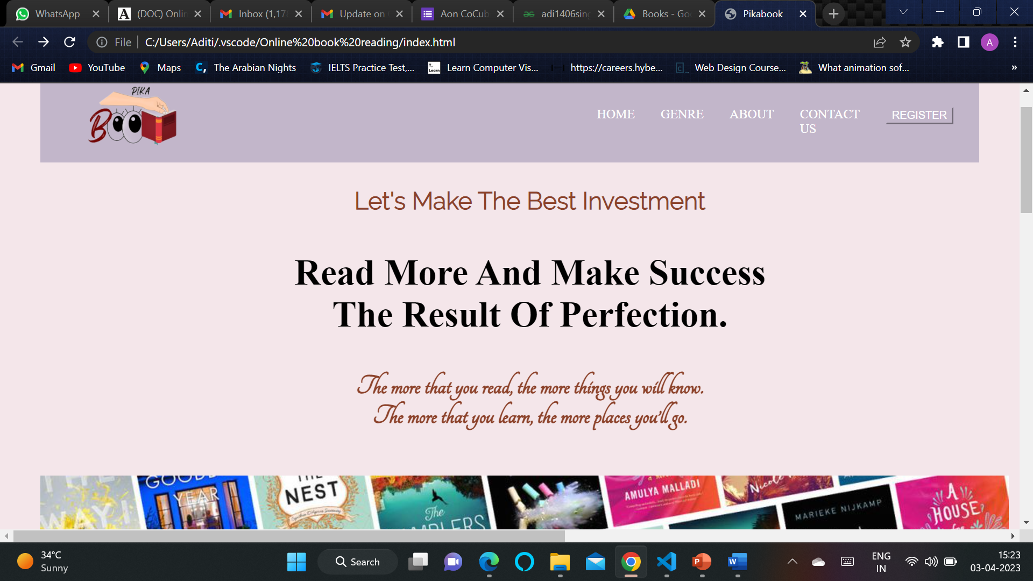
WEBSITE NAVIGATION
The websites homepage opens up with a navigation bar which consists of different tabs like home ,genre , services, about and register.

Slide 7
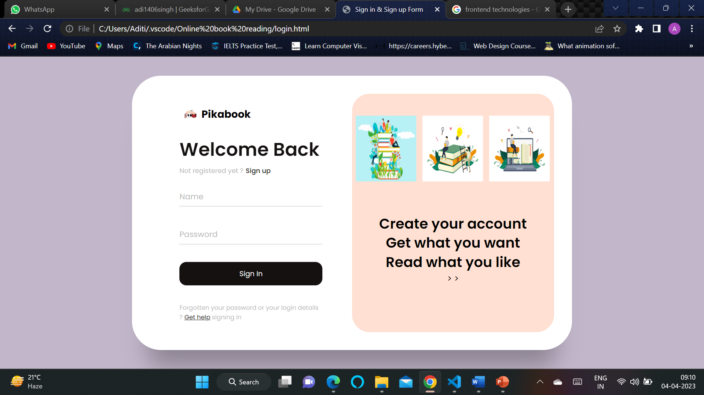
By clicking on the register button , the registration page opens where new users need to register first and existing ones can login by typing username and password.

Slide 8
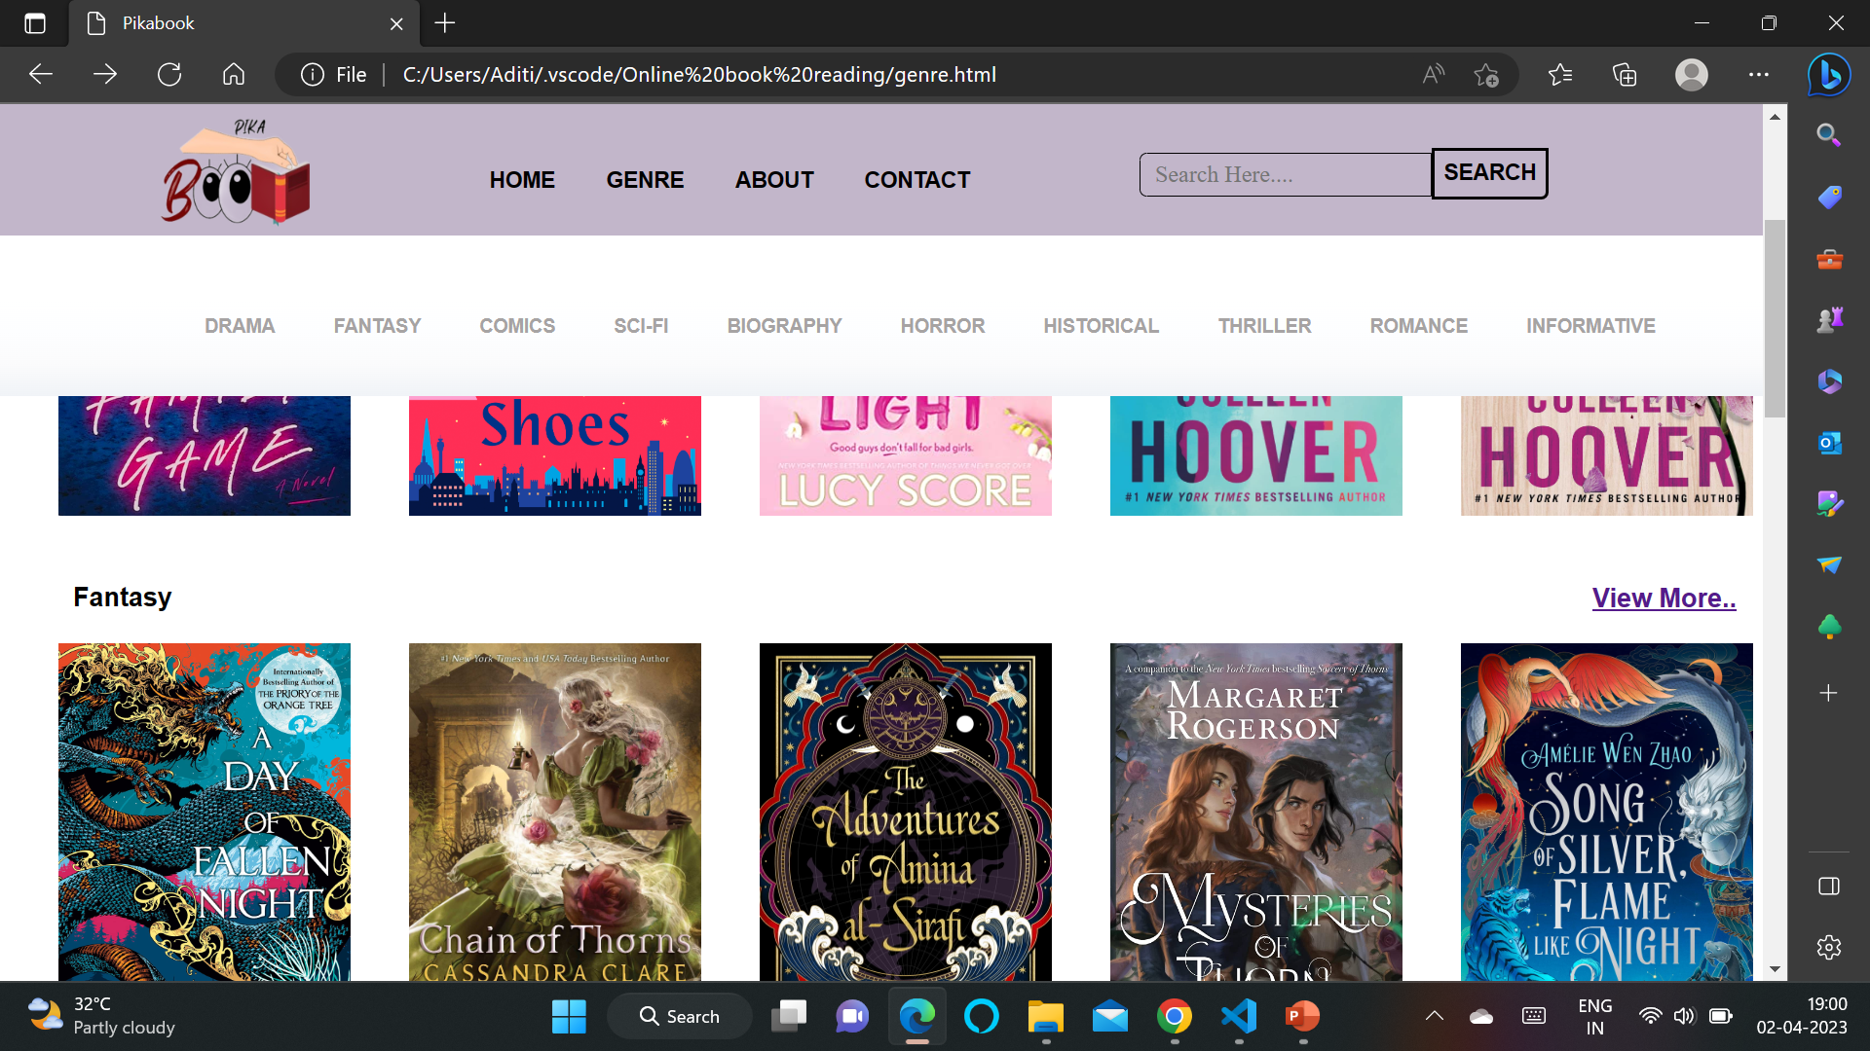
After completing these simple steps you can start reading books of your choice ;) based on the different genre.

Slide 9

FUTURE ENHANCEMENT
Best version
To add functionality to post blogs.
To add functionality to sell books.
To add functionality to keep personal notes and upload of hard-written notes .
To make the UI more Interactive and responsive.
Good Version

Slide 10
CONCLUSION
At last we can conclude that online reading is very time saving , energy saving and also beneficial for our users as compared to the traditional way of reading because of its easily accessible online materials like news , blogs , e-books , picture books , novels etc. We have tried to include all the stuffs that readers and learners needs for better experience like notes , selling and purchasing of textbooks , hand-written notes , writing blogs etc.

Slide 11

Thank You
For Visiting
PikaBOOK

